Slide 1

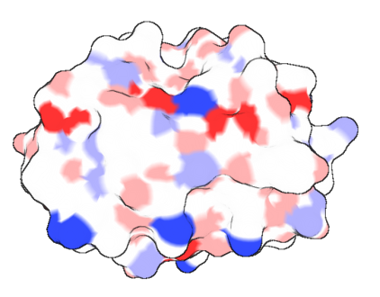
Protein Structure
Sue Jones
IBioIC Bioinformatics Section 4
Strathclyde University
16/17th March 2017
sue.jones@hutton.ac.uk

Slide 2
Outline
What is protein structure?
How do we know about protein structure?
Where and how is protein structure data stored?
Why is it important?
Sequence/structure/function relationships
What can we do with protein structure information?
Visualising and analysing protein structure

Slide 3
Section 1
What is protein structure?
How do we know about protein structure?
Where is structure information stored
Practical 01: Exploring the protein structure databank (RCSB)

Slide 4
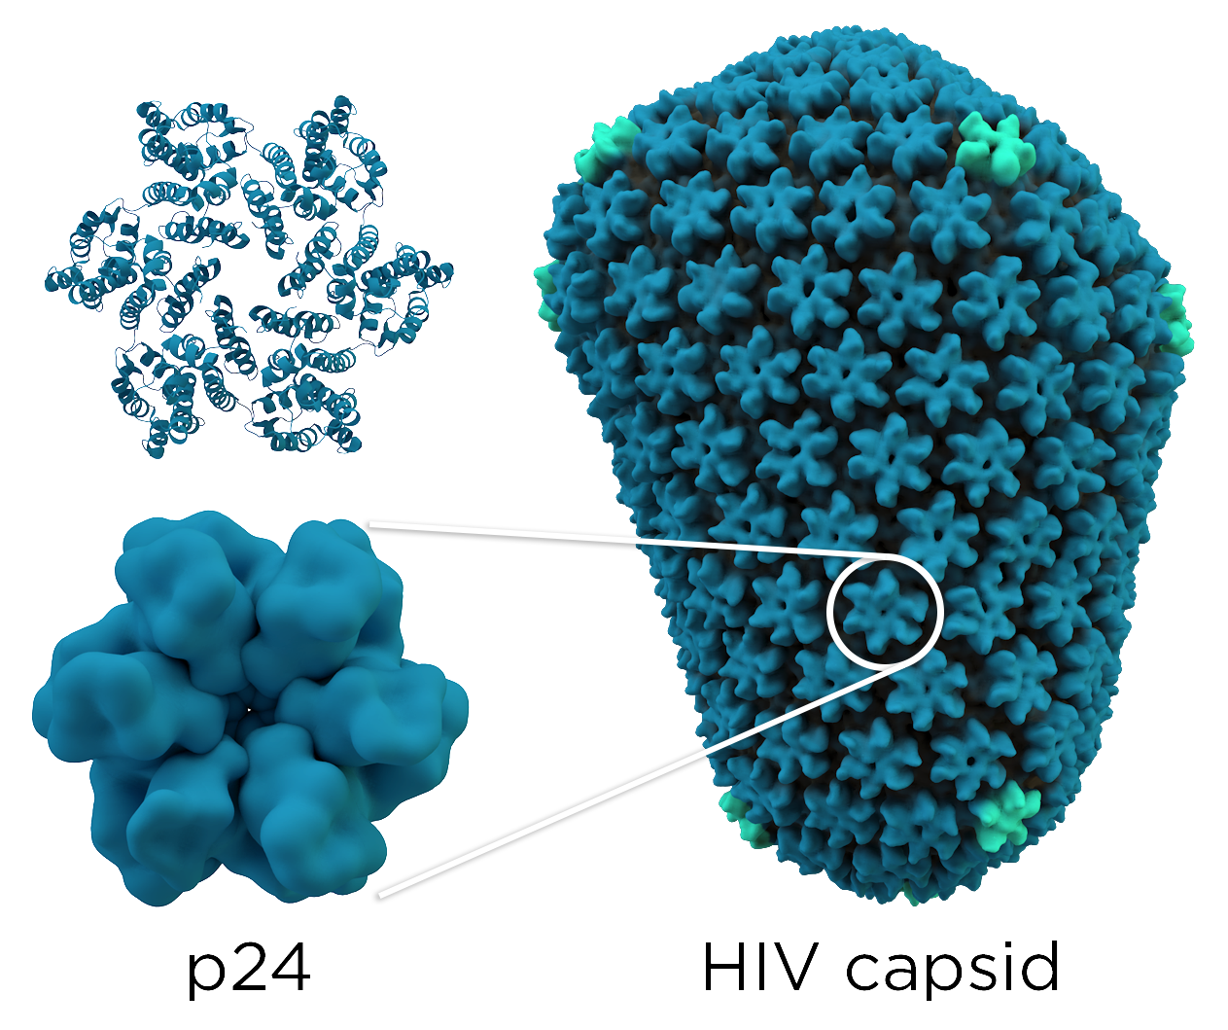
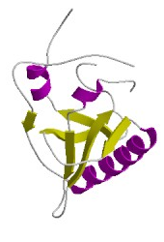
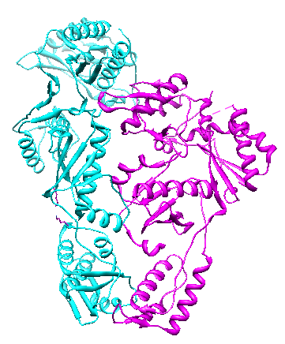
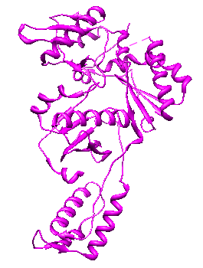
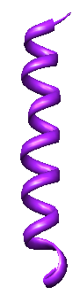
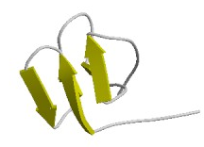
What is protein structure?
Hierarchical organisation
Primary (sequence), secondary (strands, helices), tertiary (fold)
Quaternary: dimers, tetramers, n-mers
MGTNFPFWVSQ
Domain (3dlkB01)
Secondary structure elements
Chain (3dlkB)
Protein (3dlk) -
HIV-1 reverse transcriptase

Slide 5
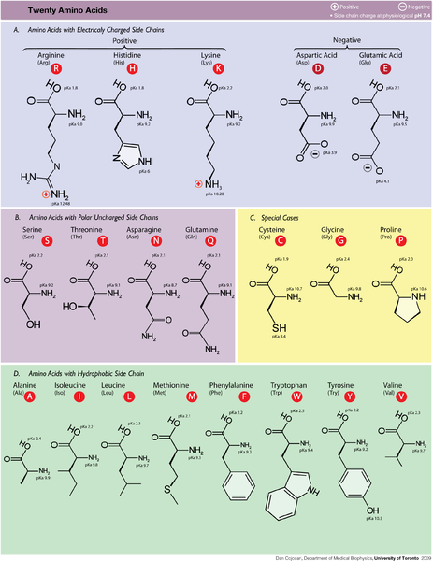
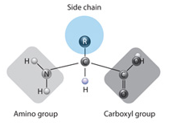
Amino acid structures: sidechains

Slide 6
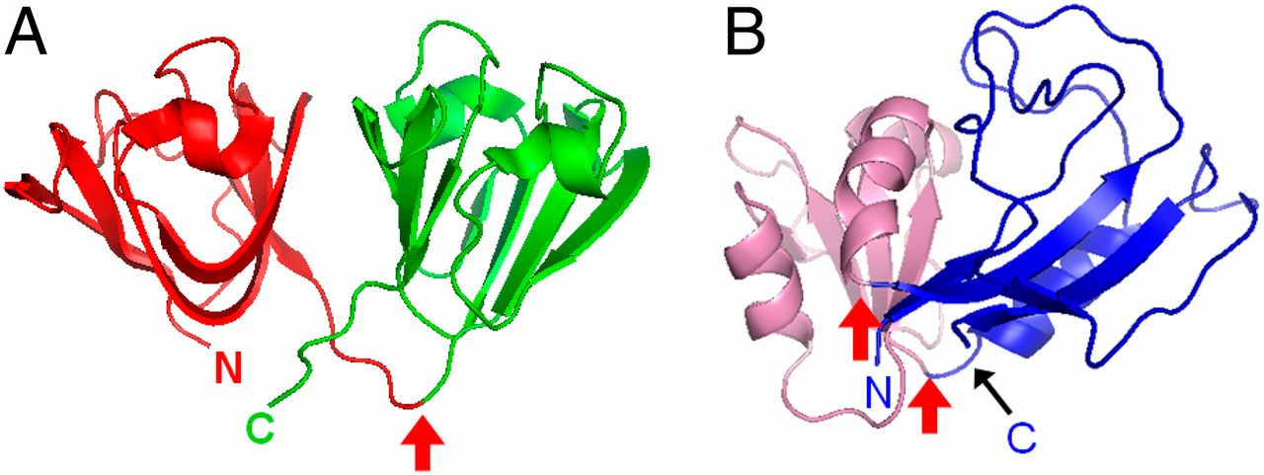
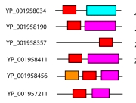
Protein Domains
Domains are “units of evolution”
evolve and exist independently
often can fold independently
~ 40% PDB proteins multidomain ~60-80% of genes in known genomes code for multidomain proteins
Domains ‘re-used’ in many different proteins
Combined in different ways
Human γD-crystallin (1HK0): 2 independently foldable domains connected by a single linker

Slide 7
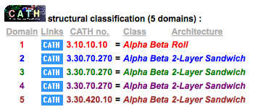
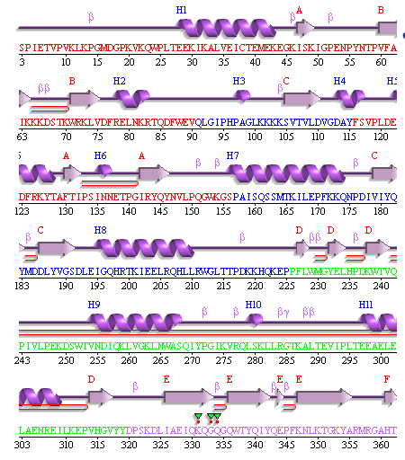
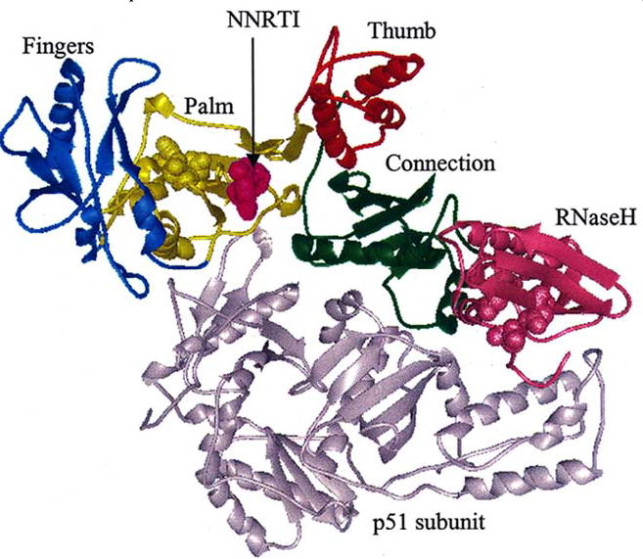
Domains can be discontinuous
Protein folding brings together parts of the sequence that are not contiguous
E.g. HIV1 reverse transcriptase (3dlk)
E.g. Dihydrofolate reductase (1rx1) sequence domains vs structural domains
Images from PDBsum
Takashi Inanami et al. PNAS 2014;111:15969-15974
Notes:
(A) Human γD-crystallin (PDB ID: 1HK0), which has two independently foldable domains connected by a single linker. (B) DHFR (PDB ID: 1rx1), which is topologically more complex, comprising two domains, DLD (blue) and ABD (pink). DLD is a discontinuous domain comprising the N- and C-terminal parts of the chain, and ABD and DLD are connected by two linkers.

Slide 8
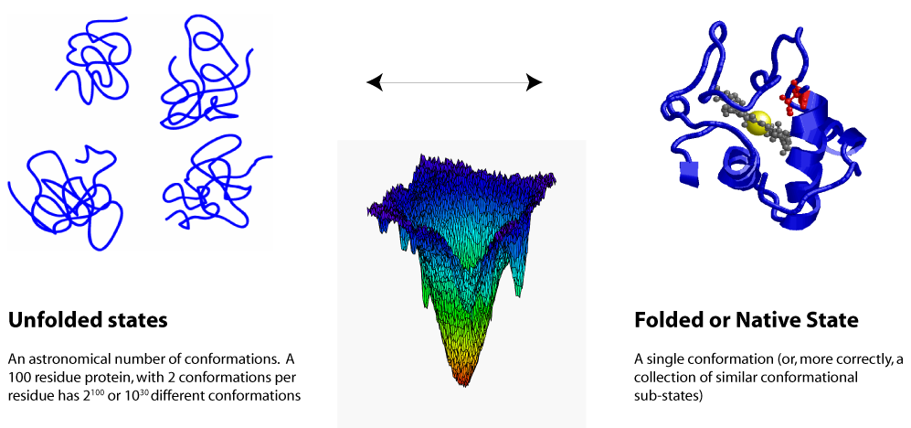
Protein folding: native state
Protein usually fold into a ‘native conformation’: minimum free energy state
energy determined by interactions: mainchain, sidechain, solvent
Proteins evolved so that a single way of folding is thermodynamically much more stable than alternative ways
Notes:
“Systems at constant temperature and pressure find an equilibrium state that is a compromise between comfort (low enthalpy) and freedom (high entropy), to give a minimum Gibbs free energy, G. (G=H-TS)

Slide 9
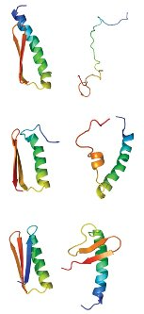
How to achieve a stable native state?
Native conformation needs to satisfy many requirements:
Hydrophobic residues: packed inside the core away from water (hydrophobic effect)
Interior : densely packed to maximise interactions
Polar groups on the inside : hydrogen bond to other groups (formation of helices and sheets)
All residues must have stereochemically allowed conformations

Slide 10
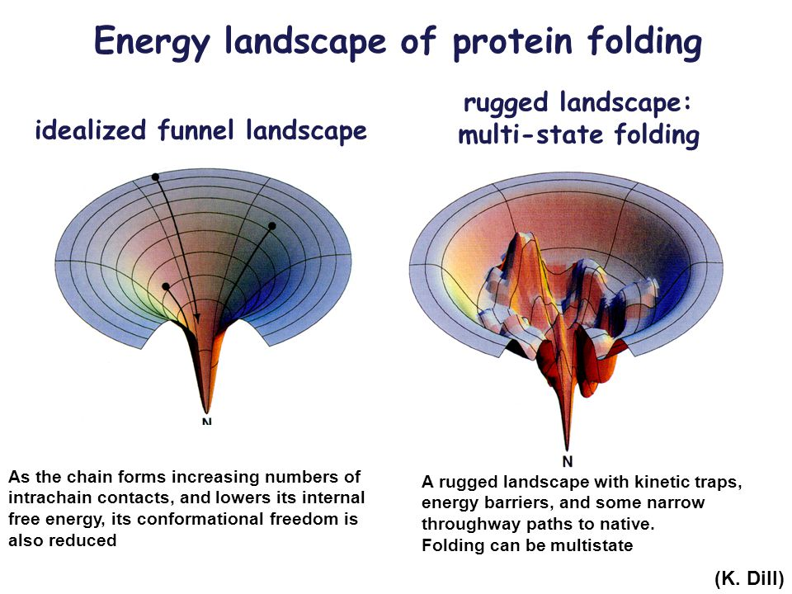
Protein folding: Folding funnels
Number of conformations a protein needs to sample to fold to the native state is BIG: need longer than the age of the universe to fold
Yet most proteins can fold in millisecond time scales (Levinthal paradox (60’s))
Folding is cooperative, i.e. steps towards native state are improvements on preceding steps
Residues do not randomly search the conformational space
http://dillgroup.org/energy-landscapes.html
Notes:
Levinthal suggested that the native state might not be the lowest energy one, if the protein can be trapped kinetically in a higher energy state (see picture on the right).

Slide 11
How do we know about protein structures?
X-ray crystallography
Nuclear Magnetic Resonance
Electron Microscopy (CryoEM)
Combination techniques

Slide 12
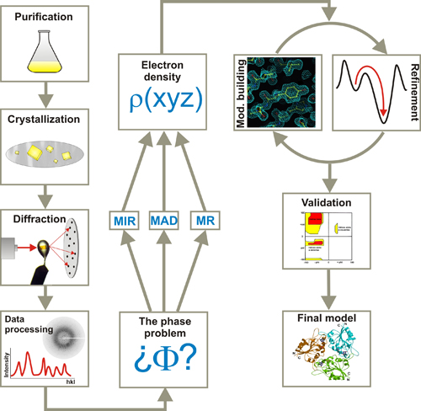
X-ray crystallography
Crystals are formed by regular arrays of molecules that diffract x-rays in regular and predictable patterns
Proteins fixed in a crystal
Snapshot of single protein conformation

Slide 13
Quality of a structure - Resolution
Resolution: measure of the amount of detail present in the diffraction pattern and corresponding computed electron density map
Lower the number the better the resolution
www.pdb.org
Notes:
http://www.pdb.org/pdb/static.do?p=education_discussion/Looking-at-Structures/resolution.html
Electron density maps for structures with a range of resolutions are shown. The first three show tyrosine 103 from myoglobin, from entries 1a6m (1.0 Å resolution), 106m (2.0 Å resolution), and 108m (2.7 Å resolution). The final example shows tyrosine 130 from hemoglobin (chain B), from entry 1s0h (3.0 Å resolution). In the pictures, the blue and yellow contours surround regions of high electron density, and the atomic model is shown with sticks. The electron density was imaged using the Astex viewer that is available on the Structure Summary page for each entry

Slide 14
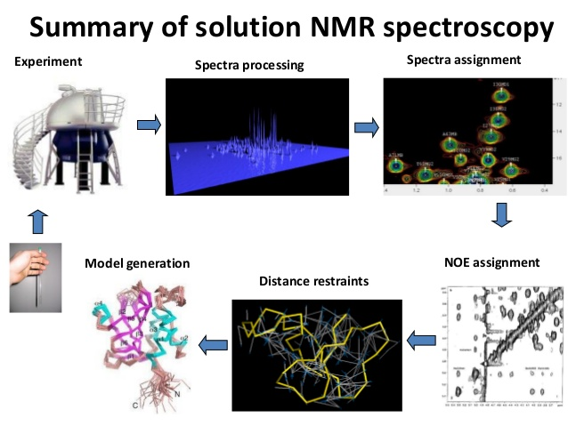
Solution NMR
Nuclei of isotopes such as 1H, 13C and 15N carry magnetic dipoles
Take up different orientations with different energies in the magnetic field of an NMR spectrometer
nuclei in different environments resonate (vibrate) at different frequencies,
plotting intensity against frequency gives a 1- dimensional NMR spectrum
Multidimensional spectrum
Proteins in solution

Slide 15
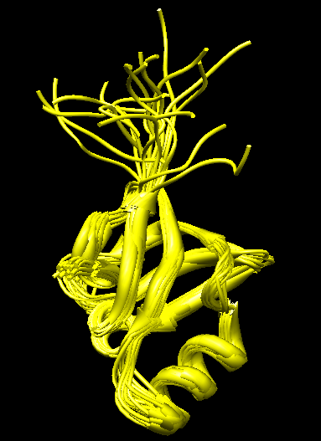
NMR: Strengths and limitations
Difficult to estimate the reliability of NMR structures from PDB
Structures often excluded from high-quality datasets used to train and test software
Proteins are studied in a more natural environment (in solution)
Applicable to membrane proteins, disordered or unfolded proteins Dynamics of the protein can be studied
Originally limited limited to ‘small’ proteins (<50 kDa)

Slide 16
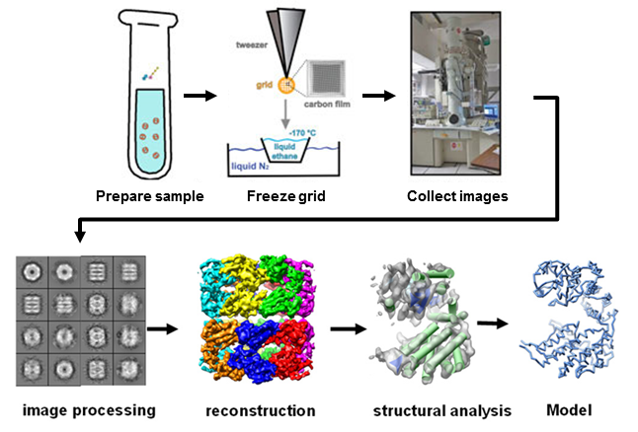
Cryo-Electron Microscopy
Imaging radiation-sensitive molecules in transmission electron microscope using very low temperatures
Initially poor resolution 10Å
Now resolution < 3.0 Å

Slide 17
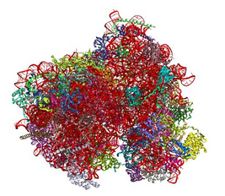
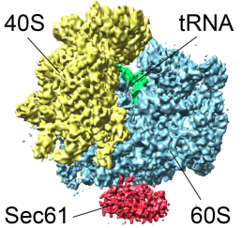
Cryo-EM Success: Ribosome
Human 80s ribosome (3.5Å)
69 protein chains & 5 nucleic acids

Slide 18
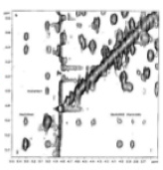
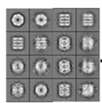
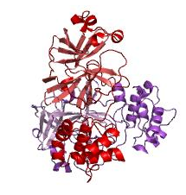
Protein structures are models
Easy to consider a protein structure as the “true” three-dimensional structure of a protein
In reality, every structure is a model that fits the experimental data to a reasonable degree
Experimental data can also contain errors!
Not all structures are equal!

Slide 19
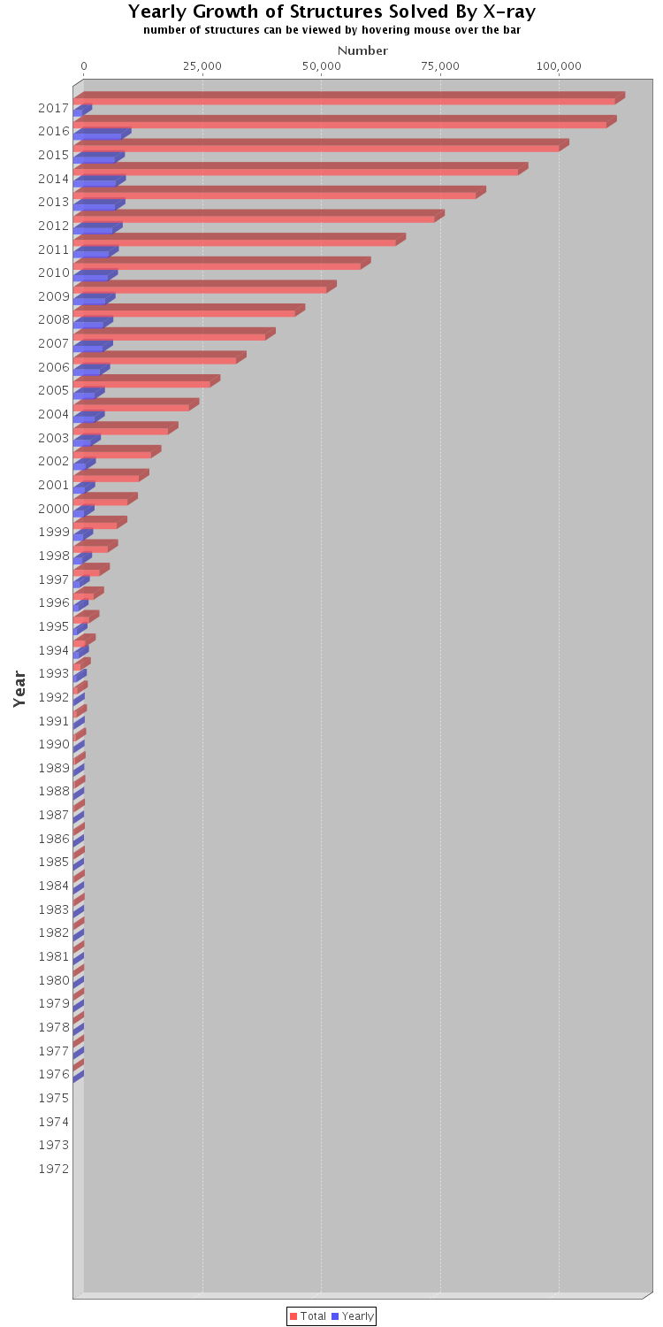

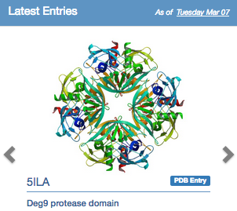
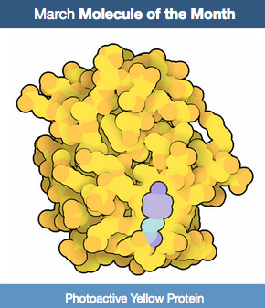

Where are protein structure stored?
www.rcsb.org

Slide 20
Practical 04-01
Searching for data in the Protein structure database (RCSB)

Slide 21
Section 2
Protein structure file format
Protein structure visualisation

Slide 22
RCSB Protein Structure File Format
New PDBx/mmCIF: ‘macro-molecular Crystallographic Information File'
RCSB entries distributed in PDBx/mmCIF file format standard in 2014
Old PDB format not been modified or extended since 2012: now frozen
As PDBx/mmCIF format evolves PDB format files will become outdated
190 page file format description! ftp://ftp.wwpdb.org/pub/pdb/doc/format_descriptions/Format_v33_A4.pdf
Based on context free simple grammar: Data are presented in either key-value or tabular form. It is much easier to parse than the record-oriented PDB format
Parsing tools available in most languages and toolkits (bioPython, bioJava)

Slide 23
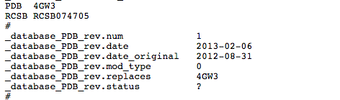
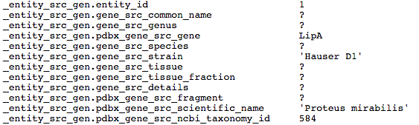
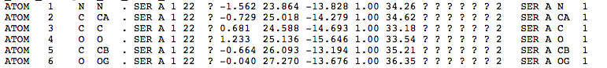
PDBx/mmCIF format
? Missing values: col 9: insertion code
Col 15: sigma X : standard uncertainty of coordinate (0.01% of PDB entries)

Slide 24
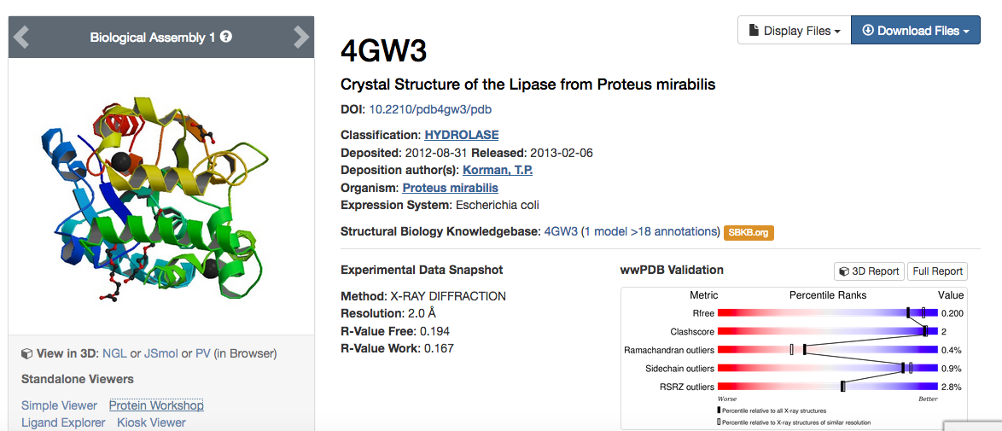
PM Lipase structures in the RCSB

Slide 25
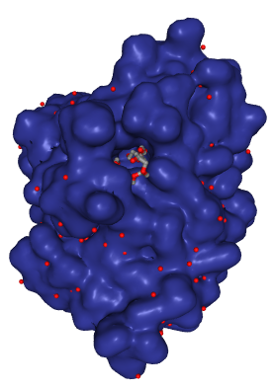
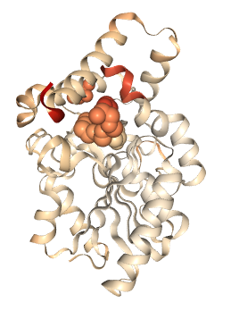
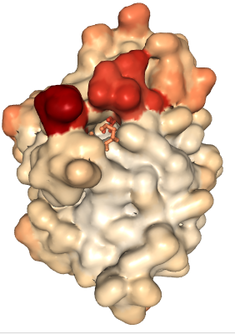
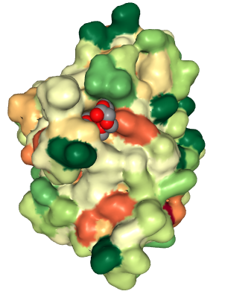
Protein structure visualisation

Slide 26
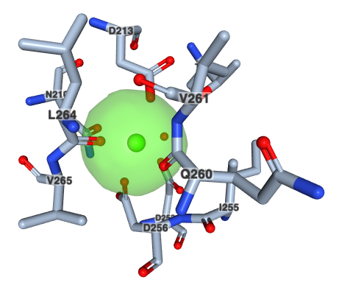
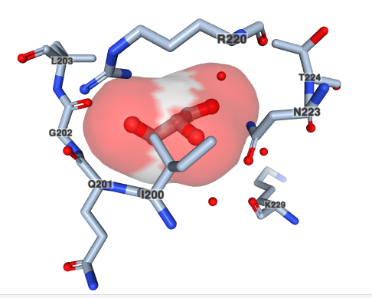
Protein structure visualisation
Red- glycerol, green calcium

Slide 27
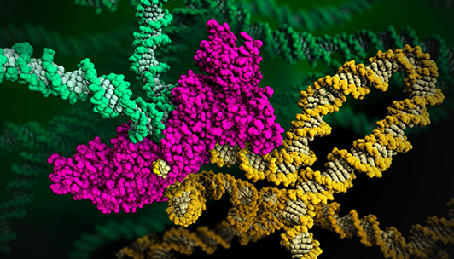
Structures become art

Slide 28
Practical 04-02
Protein structure visualisation using NGL – a web-based viewer

Slide 29
Section 3
Sequence/structure/function relationships
Protein families
What can protein structure be used for?

Slide 30
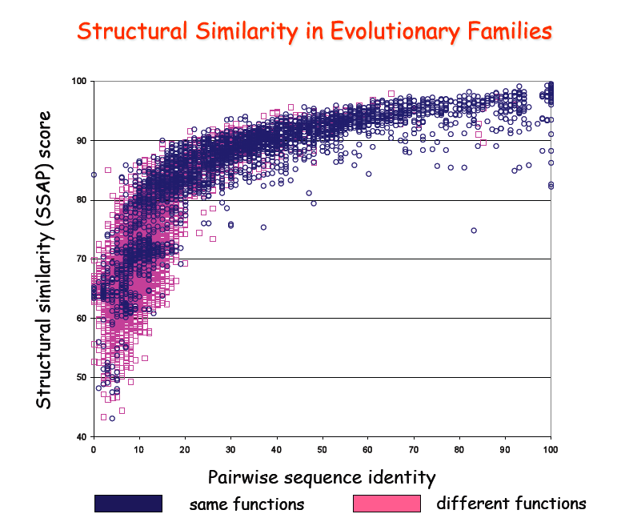
Sequence/Structure/Function relationships
Proteins with low sequence similarity can have very similar structures
Christine Orengo, UCL

Slide 31
Sequence/Structure/Function relationships
Proteins with high sequence similarity can have very different structures
No absolute rules
Two designed proteins with 7 amino acid differences (in red).
Change: all-alpha fold to an alpha/beta fold
88%sequence identity
He et al. (2008) PNAS, 105,14412

Slide 32
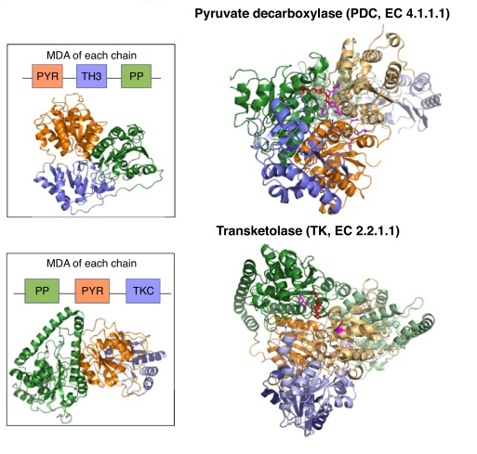
Sequence/structure/function relationships: domain context
Das et al., (2015) Curr Opin Genet Dev: 35:40

Slide 33
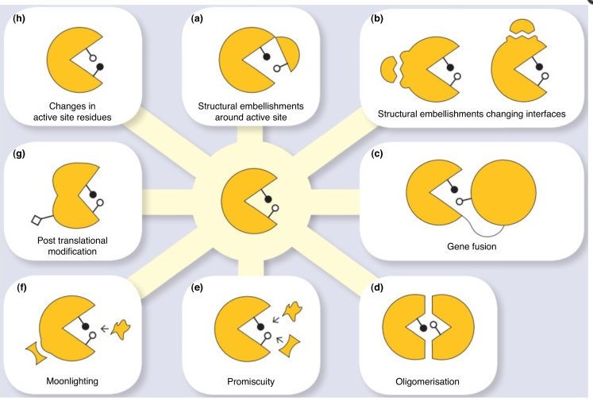
Sequence/structure/function: functional diversity
Functional diversity can arise due to one or more mechanisms
Das et al., (2015) Curr Opin Genet Dev: 35:40

Slide 34
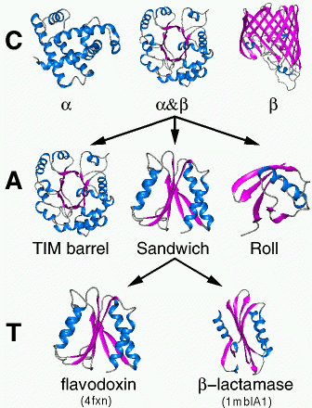
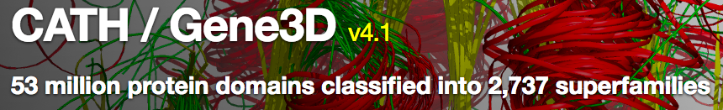
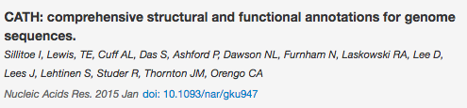
Protein structure classification
Families arise through speciation (orthologous relatives) and duplication (paralogous relatives)
Explore how relatives diverge and mechanisms for functional change
Hierarchical classification : CATH and SCOP
As more structures solved: where does one fold end and another begin?: Fold continuum
www.cathdb.info/

Slide 35
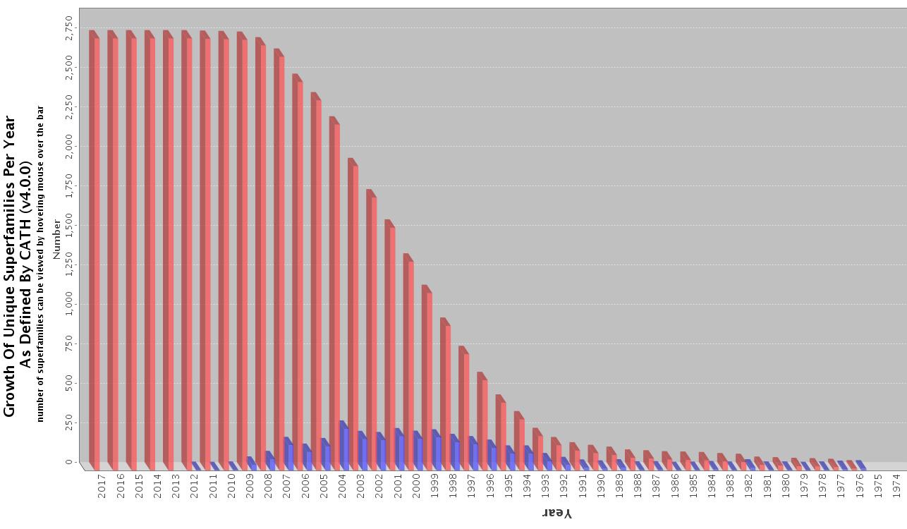
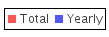
Limited number of folds?
http://www.rcsb.org/pdb/statistics
Notes:
Structures are currently being added at about 10K per year but there haven’t been new superfamilies in the last few years.

Slide 36
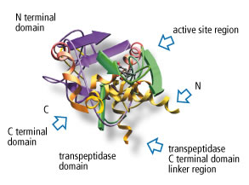
What can a protein structure be used for?
Understand the function of a protein
Understand/explain observations from experiment (e.g. the relationship between stability and mutation of a specific residue)
Understand the binding mode of a ligand
Protein design: engineered binding sites, engineer greater stability, engineer ‘new’ functions

Slide 37
Practical 04-03 Practical 04-04
Protein structure visualisation using Jmol
Functional regions in the WT PM lipase (4GW3)
Mutation sites and their effects in Dieselzyme4 (4HS9)
Superimposing WT and mutant proteins to see differences in structure

Slide 38
Section 4
Protein sequence-structure gap
Predicting protein structure from sequence

Slide 39

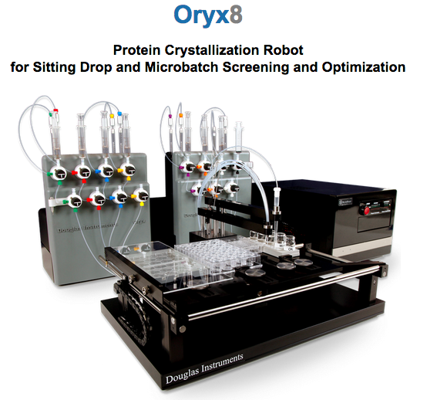


Sequence Structure gap
77 million protein sequences / 123,000 protein structures
Sequencing is easy: experimentally determine structure: difficult
As sequencing gets easier and cheaper the gap will grow
Structural genomics consortia: targeting ‘important’ proteins
Important = human = drug targets
Robotics for crystallization processes: using 96 well plates to test out conditions
http://www.thesgc.org/

Slide 40



Secondary structure prediction
Neural networks are a common feature of SS prediction methods

Slide 41
Predicting tertiary structure from sequence : options
MLRLVVGALLLVLAFAGGYAVAACKTVTLTVDGTAMRVTTMKSRVIDIVEENGFSVDDRDDLYPAAGVQVHDADTIVLRRSRPLQISLDGHDAKQVWTTASTVDEALAQLAMTDTAPAAASRASRVPLSGMALPVVSAKTVQLNDGGLVRTVHLPAPNVAGLLSAAGVPLLQSDHVVPAATAPIVEGMQIQ
No significant sequence similarity to protein with known structure:
no homologues
Significant sequence similarity to a protein with known structure
: homologues
homology modelling
(comparative modelling)
ab initio modelling

Slide 42




Ab initio modelling
Threading
Jones et al., 1992. Nature. 358, 86-89.
Fragment assembly
Simons et al., JMB 1997: 268:209

Slide 43


Homology modelling
A multi-step process, possibly with several iterations
http://swift.cmbi.ru.nl/teach/B4/drgdes_3.html

Slide 44

Typical errors in comparative modelling
M.Topf
Notes:
Incorrect templates: If identity is less than 25% it is difficult to know if the errors are due to incorrect templates or bad alignments.
Misalignment: common source of error. Can be fixed by using multiple sequence alignment that is more informative or manual editing.
Region without template: these are very difficult to predict if they are longer than 9 residues.
Distortions/shifts in correctly aligned regions: even with correct alignments, it’s possible to have shifts in conformations that cannot be predicted.
Sidechain packing: the core residues may be packed differently as the sequence identity drops. This can be serious problem for ligand binding or active sites.

Slide 45


Model evaluation
All models wrong: question is by how much.
Evaluate:

Slide 46
Practical 04-05
Predicting secondary structure from sequence
Predicting tertiary structure from sequence using homology modelling

Slide 47
Section 5
It is not all about structure

Slide 48





It is not all about structure: unstructured proteins
Intrinsically unstructured protein common in proteomes (IUPs)
Coupled folding and binding (fly-casting)
Uversky et al, 2000, Proteins 41:415-4

Slide 49


It is not all about structure: unstructured proteins
Function directly linked to structural disorder
Binding to multiple partners

Slide 50
Section 6
Summary and conclusions Acknowledgments

Slide 51
Summary
Structures solved by crystallography, NMR and cryo-EM
Data stored in RCSB
Secondary, tertiary and quaternary structure
Sequence/structure/function relationships are complex
To fully understand function you need to know the structure

Slide 52


Acknowledgements
Many slides provided by
Dr Irilenia Nobeli (Birkbeck College, London)
Additional slides
Professor Christine Orengo (UCL, London)
Professor Maya Topf (Birkbeck College, London)
Anyone who ever posted protein images or slides on the internet!

Slide 53


